Slide 1
PONG Workshop
Week of 2/7/20 – Week of 2/14/20

Slide 2


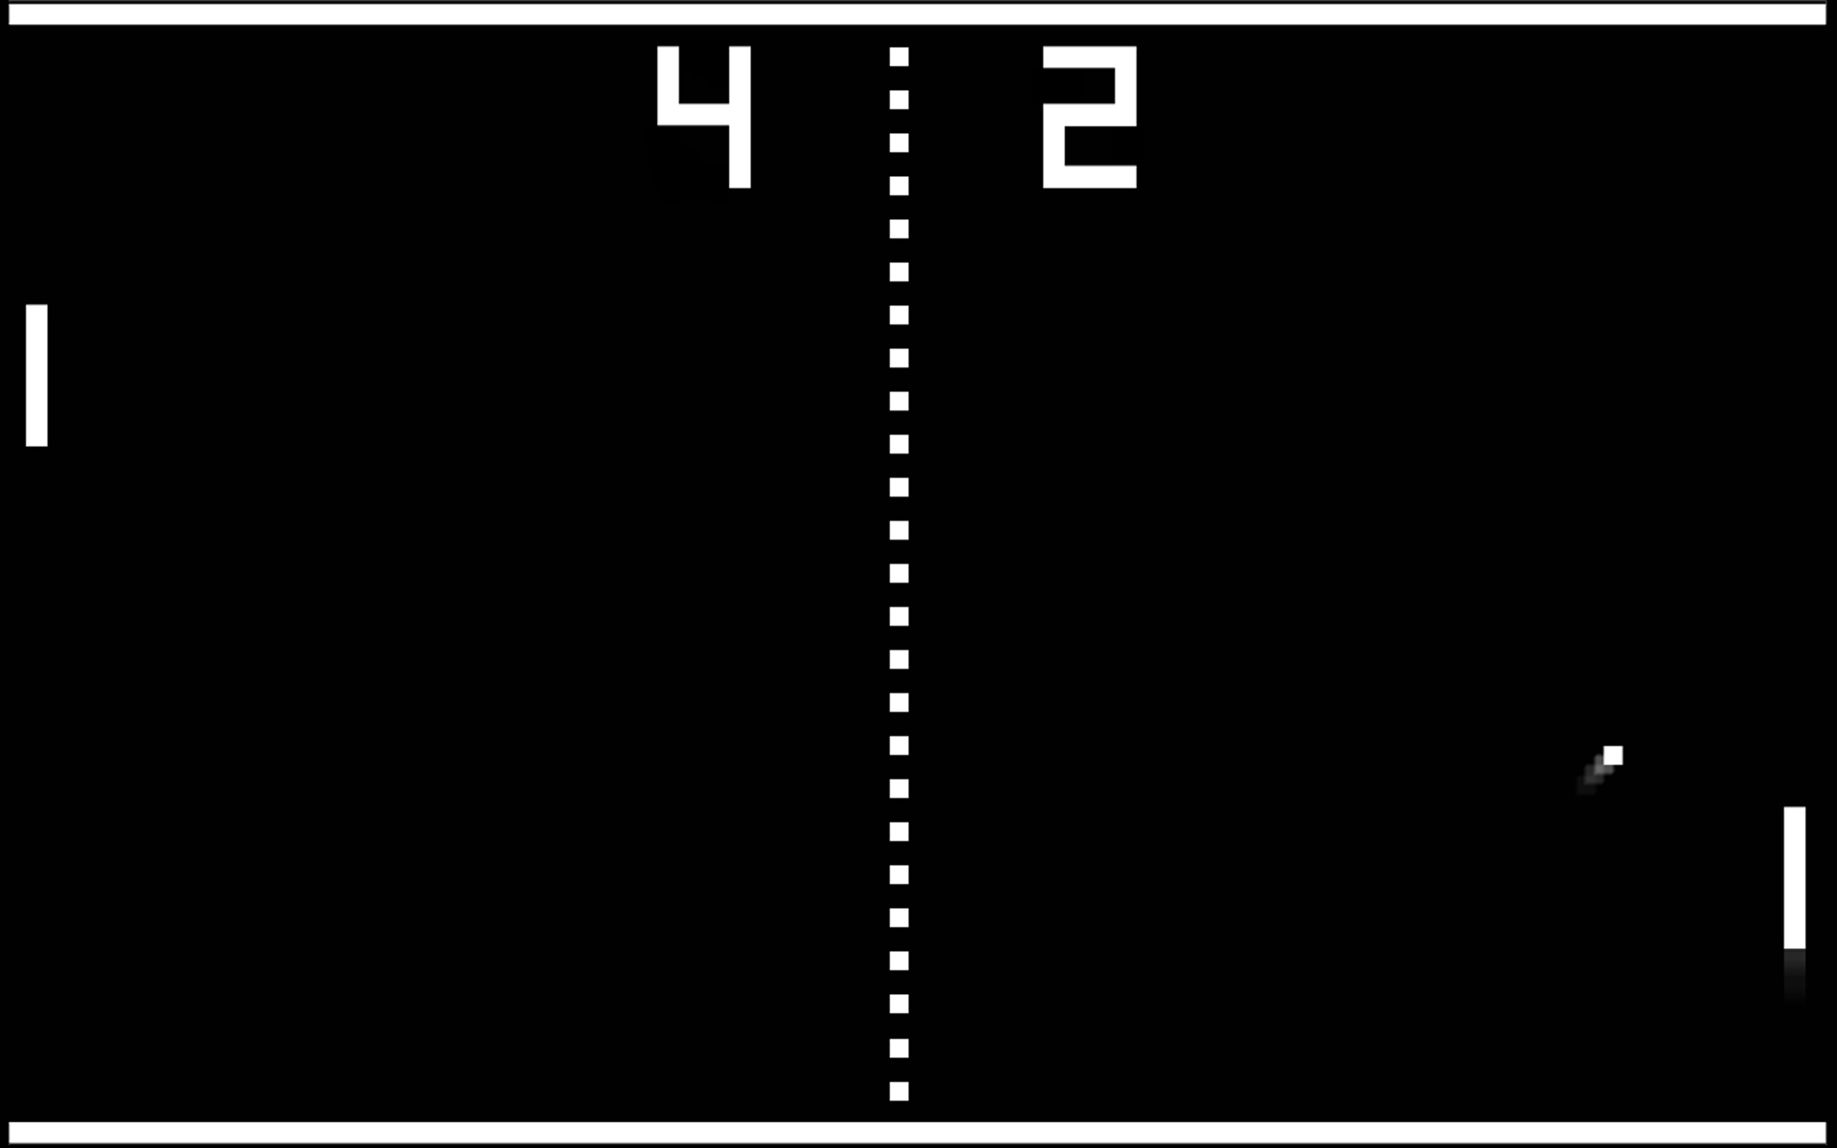
What is Pong?
Classic Arcade game published and developed by Atari
Release Date: November 29,1972
Genre: Sports
Pong was the first commercially successful video game.
It is timeless even to today’s standards

Slide 3
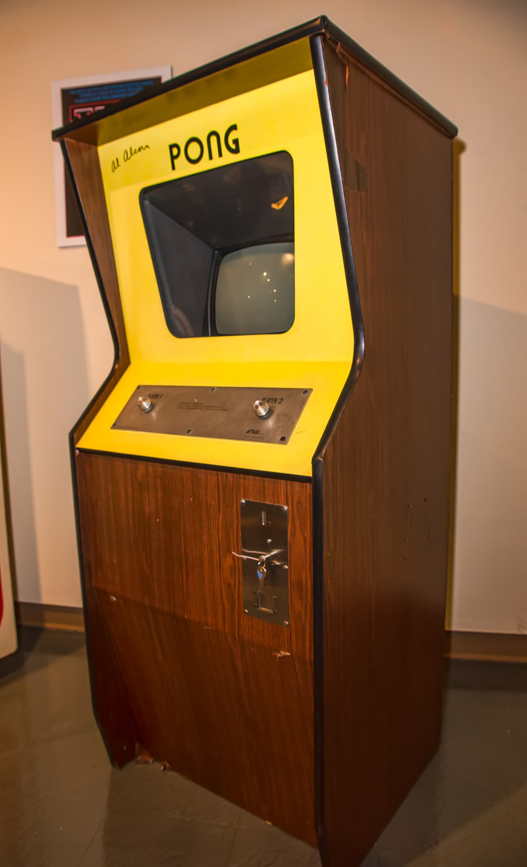
WhY Pong?
Easy game to understand
Perfect starting point to begin game development
Uses most if not all the basic tools found in Unity

Slide 4

How?

Slide 6

Assets
5 Folders:
C Scripts
Fonts
Physics Materials
Scenes
Sprite
All of these are found in the club’s GitHub

Slide 7

Quick Rundown
Today
Analyze the main functions
Establish the foundations
Play test the game
Next Week
Construct UI for the game
Add finishing touches
Complete the Build

